Slide 1
2018 Section Engineer’s Meeting
Ryan Griffith
Director of Construction
Notes:
Welcome to Lake Barkley State Park.
Glad to see everyone this year.
You may be asking yourself how did we get here this year?
Well there were a lot reasons but I’m going to give you the top ten reasons.

Slide 2
History of location of the SE meeting
Out of the last 20 SE meetings
12 at state parks (5, Cumberland,4 Barkley, 3 General Butler)
6 at hotels
2 at TCOB
Almost 10 years to the day, the SE meeting was right here.
February 5-7, 2008
It was the 2008 Super Tuesday tornado outbreak
No power at the resort.

Slide 3
Why are we back at a Park/Lake Barkley this year?

Slide 4
Top ten reasons the SE meeting is at Lake Barkley
10. Limited or no cell service will keep everyone attentive.
9. Had to prove to Darold and D12 the state doesn’t stop at Bowling Green.
8. Someone wanted to do breakouts…Lake Barkley was the only park that would accommodate.
7. Steve Gunnell said he needed some miles on the district vehicles and asked if I could help him out
6. It has been 10 years since we were here last, why not?

Slide 5
Grand Wyndam, Puerto Rico

Slide 6
Top ten reasons the SE meeting is at Lake Barkley
5. Had that place approved. KAHC reserved it first. They are there this week.
4. I gave Calebs 4 years to ask me to set courtside with him behind Calipari. I gave up.
3. Everyone here bought over a quarter of a billion dollars worth of bridges right down the road, you may as well see/use’em.
2. I noted last year that Kyle finally came to one of our meetings in Lexington. It was our turn to come to his place.
1. Ubereats won’t deliver Patty’s to Lexington

Slide 7
SE meeting 2018
Housekeeping, facilities, sign-in daily, training hours
New old arrangement
Breakouts-Construction, Maintenance, Materials, Combination.
There is an App for that. EventsXD

Slide 8
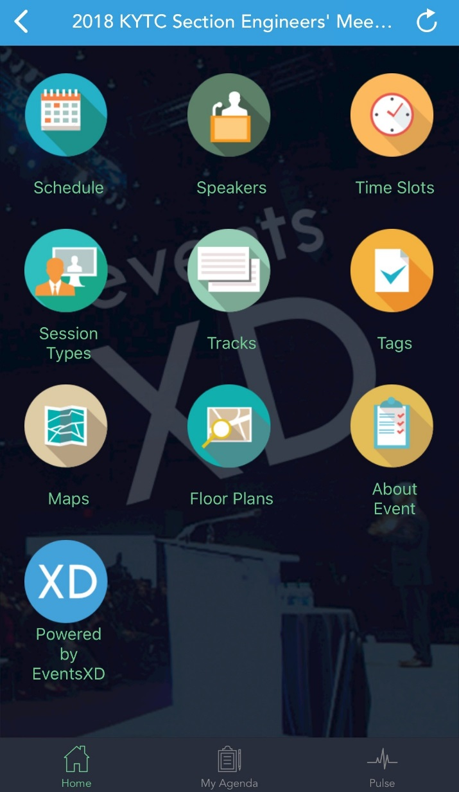
EventsXD
Survey

Slide 9
SE meeting 2018 cont.
Informative topics
Possible topics were sent out and the most popular are on the agenda (some twice).
Listen, Learn, Be engaged, and have fun.

